Slide 1

P.I.E. - Pixel Image Editor
Sprint Four Overview

Slide 2
The Plan
Project Goals:
1. A bitmap/image class to store the data.
2. Menu System functionality.
3. Event handling for multi-sized brushes
4. RGB Color selection and custom color palates.
5. Image save functionality.
Original Sp2 tasks from GitHub

Slide 3
What We Accomplished
Updated App Functionality
Created image data structure
Added save and load functionality to menu bars
Added Help button in menu that links to documentation.
Redesigned Canvas class to accomadate image data structures.
Added text based RGB inputs for color selection.

Slide 4
What We Didn’t Accomplish
Image files can be saved but the image data isn’t being updated.
2. Colors accept RGB values but don’t update the pallets themselves.

Slide 5
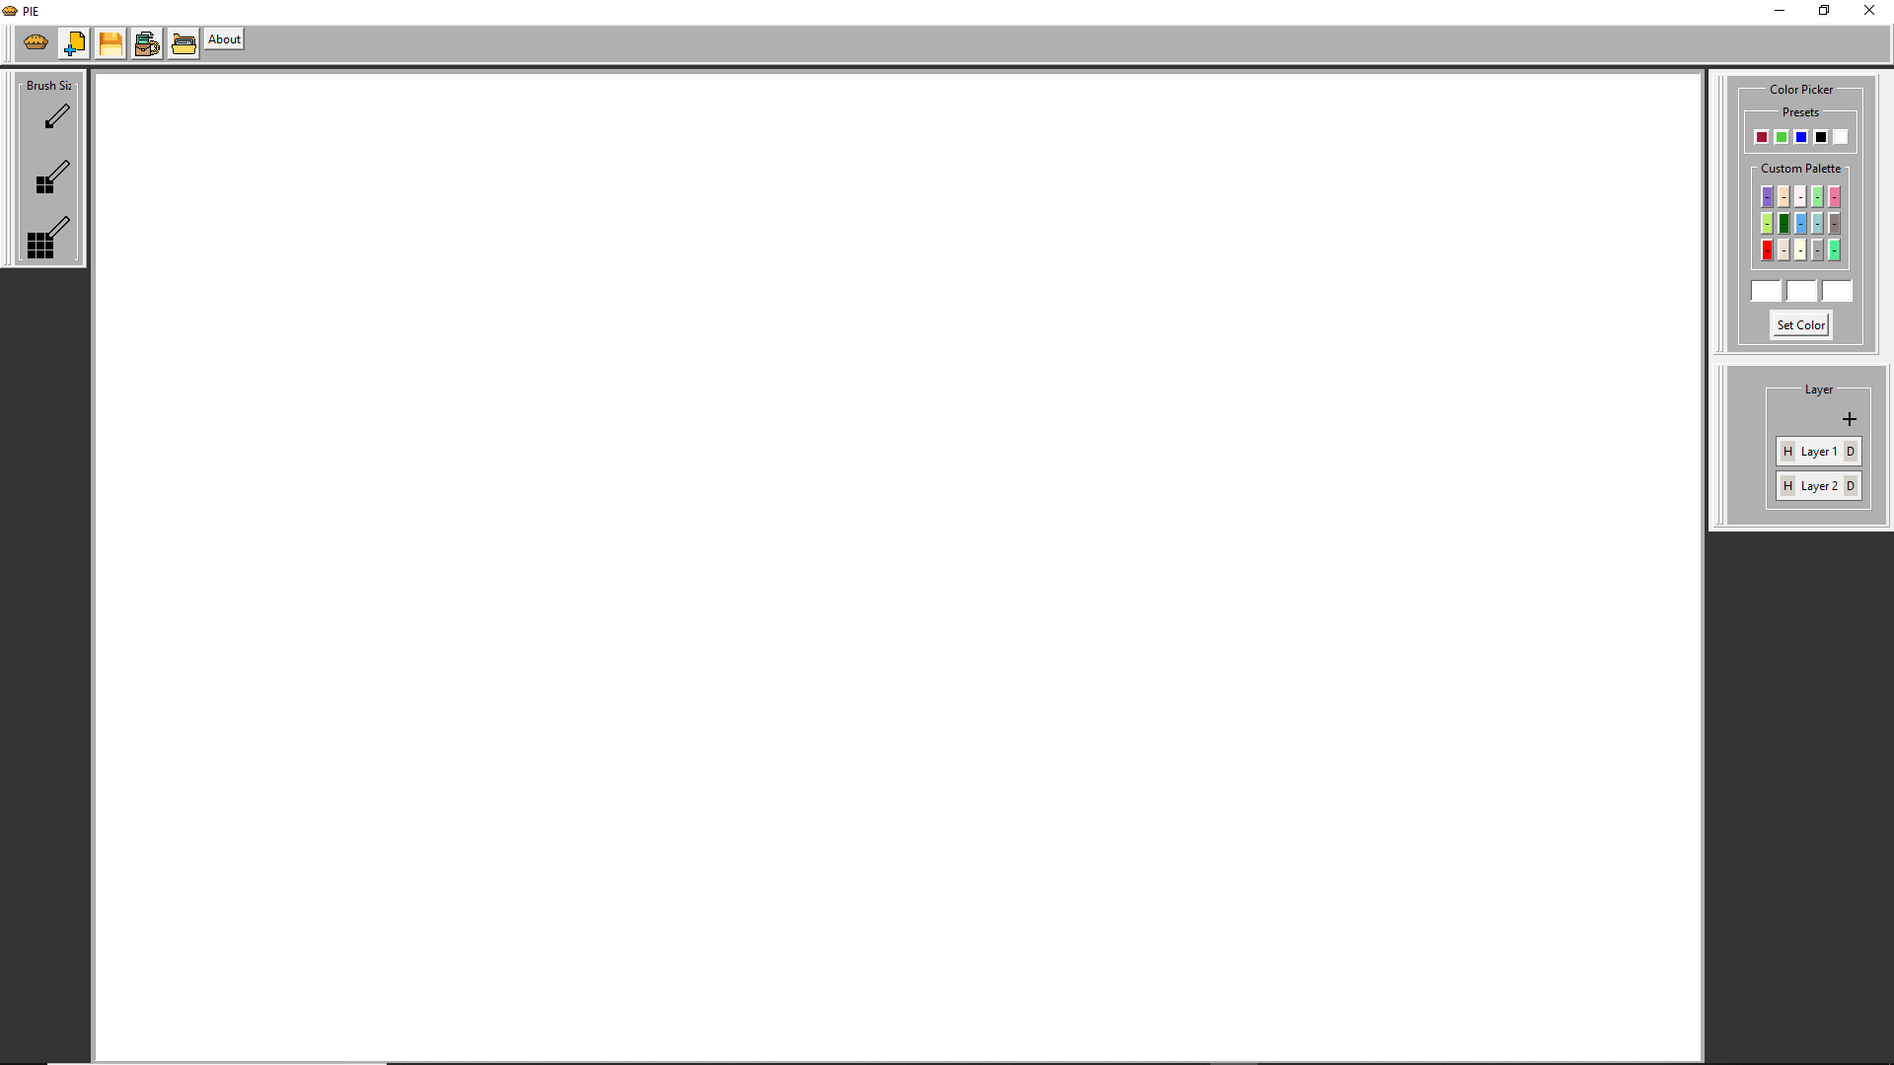
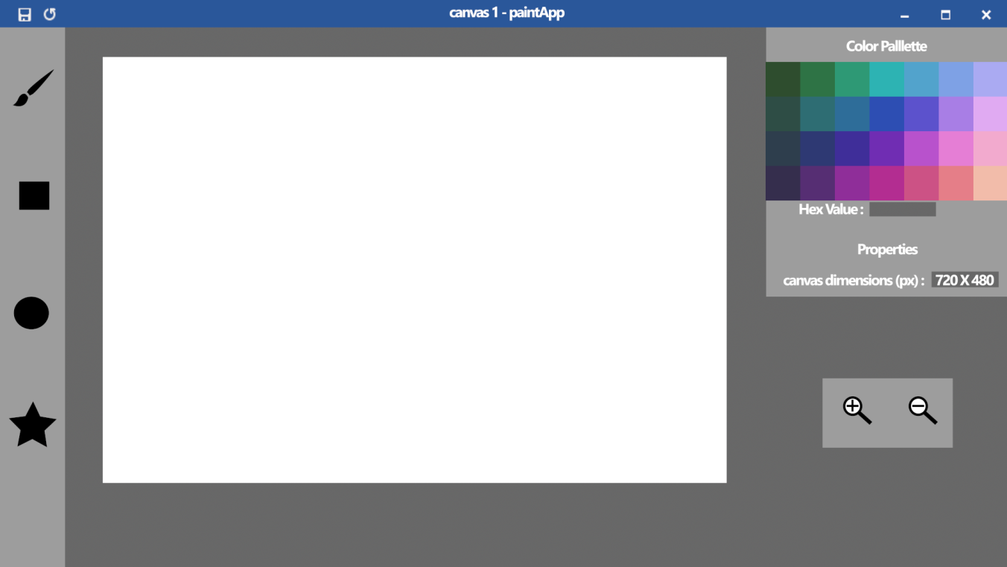
Concept V.S. Actual
P.I.E-Concept
P.I.E-Sp4

Slide 6
Hours Worked
Dustin Shaver: 17
Omar Bitar 6
Jacob Waters 10.2
Nick Miller 9
Francesco Lemon 5

Slide 7
Looking Ahead
Once canvas event handlers and save functionality are implemented, the app will be near completion. Final steps will include optimization, cleaning up bugs, implementing a color wheel, and multi-brush functionality.

Slide 8
Demo

